Slide 1
Kotlin Multiplatform Template
By SK NIYAJ ALI

Slide 2
Overview
Project Overview
Intelligent Project Synchronization
Automated Security and Key Management
Source Set Hierarchy
Design System and Platform Integration
UI Foundation and Analytics Systems
Type-Safe Navigation
Recap & Conclusion

Slide 3
KMP Multi-Module Project Generator
One Codebase, Four Platforms
Project Overview
The KMP Multi-Module Project Generator provides a comprehensive foundation for building cross-platform applications using Kotlin Multiplatform technology. This template enables development teams to create applications that run natively on Android, iOS, Desktop, and Web platforms from a single shared codebase.
Key Capabilities
The template includes production-ready configurations for continuous integration, automated testing, and deployment workflows. Development teams can begin building features immediately without spending weeks configuring build systems and project infrastructure.

Slide 4
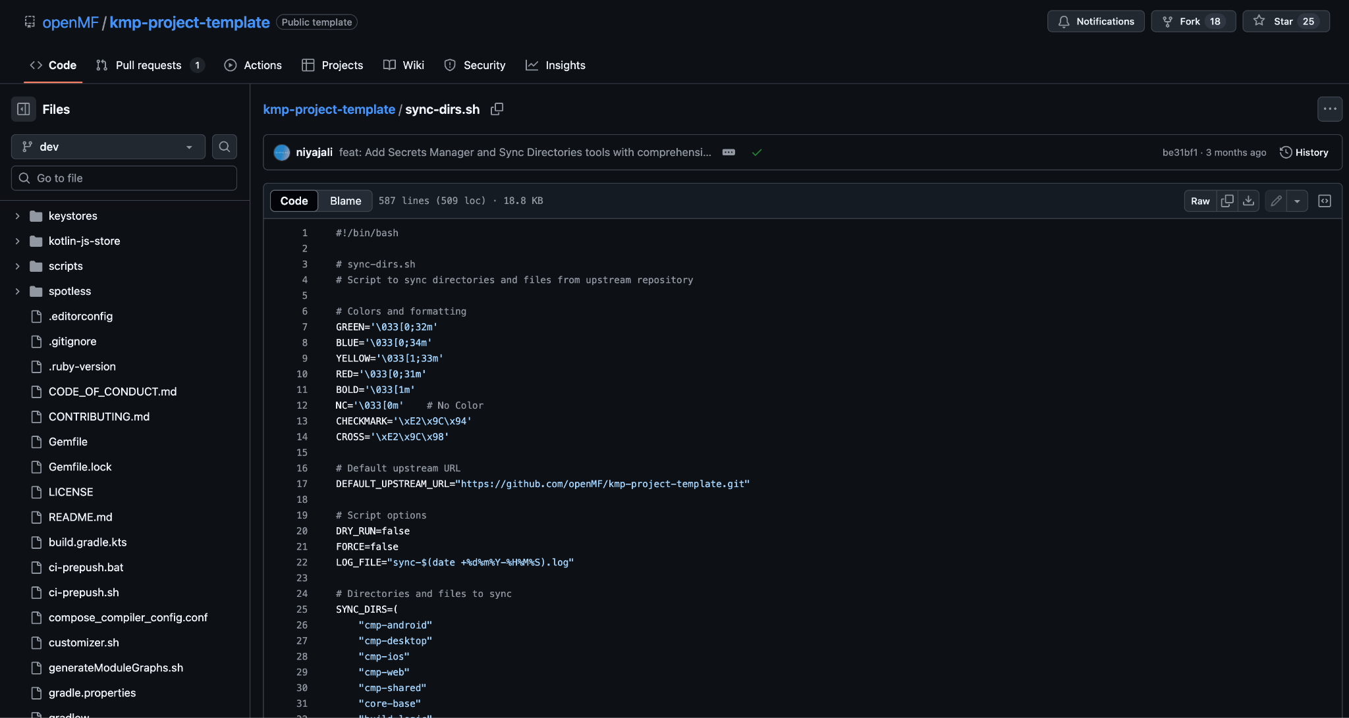
Intelligent Project Synchronization
Directory Synchronization System
The template includes sophisticated synchronization capabilities that enable projects to incorporate upstream improvements while preserving custom business logic and configurations. This system addresses the challenge of maintaining current template benefits without disrupting project-specific development work.
The synchronization tool analyzes project structure to distinguish between template infrastructure and custom application code. During updates, the system applies template improvements while carefully preserving business-specific modifications and customizations.

Slide 5
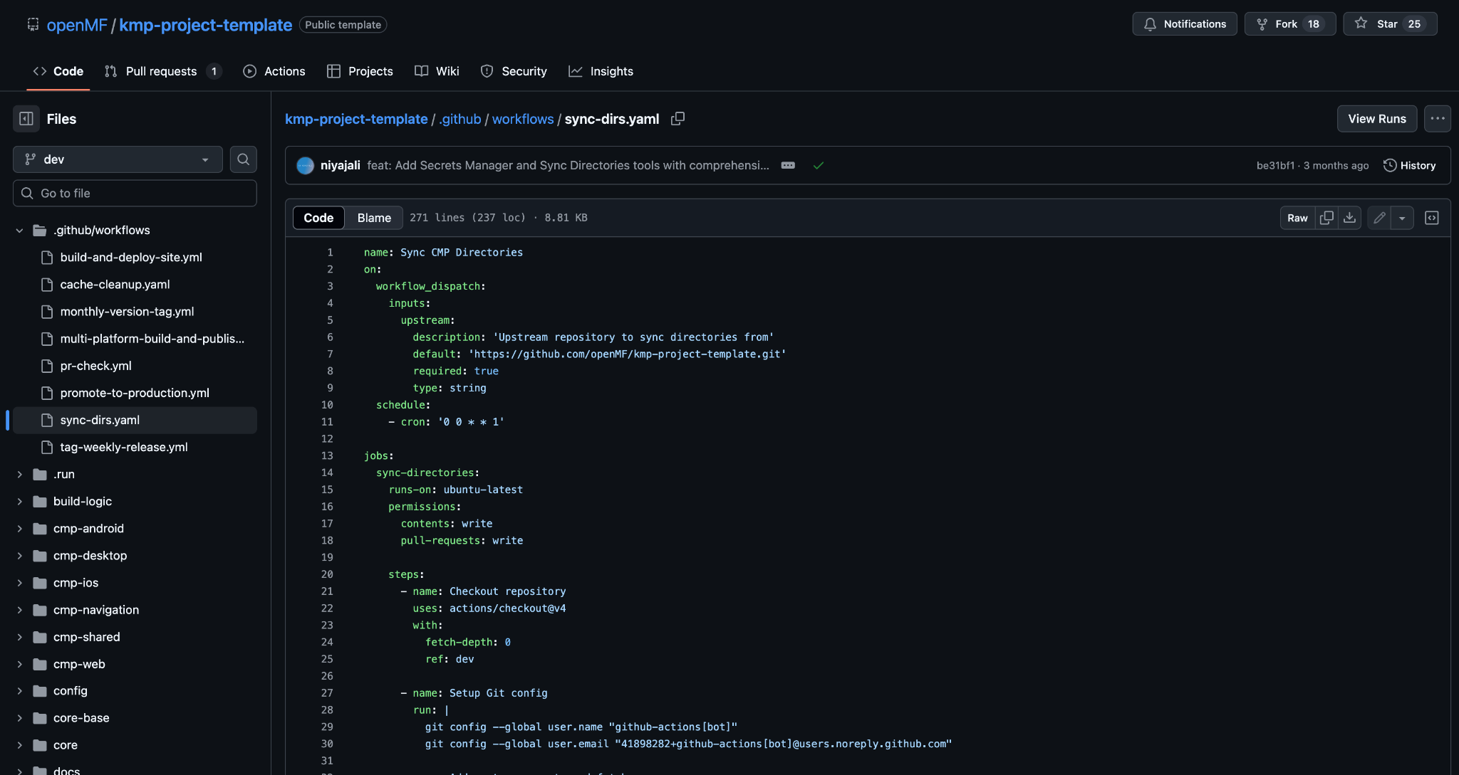
Intelligent Project Synchronization
Smart Integration Process
The tool creates dedicated review branches that allow development teams to examine proposed changes before integration. This approach ensures that updates can be tested thoroughly and applied selectively based on project requirements and compatibility considerations.
The synchronization process handles merge conflicts intelligently and provides detailed reports of proposed changes. Development teams maintain full control over which improvements to incorporate while benefiting from ongoing template enhancements and security updates.
This capability allows projects to remain current with template evolution while protecting investment in custom functionality and business-specific implementations.

Slide 6
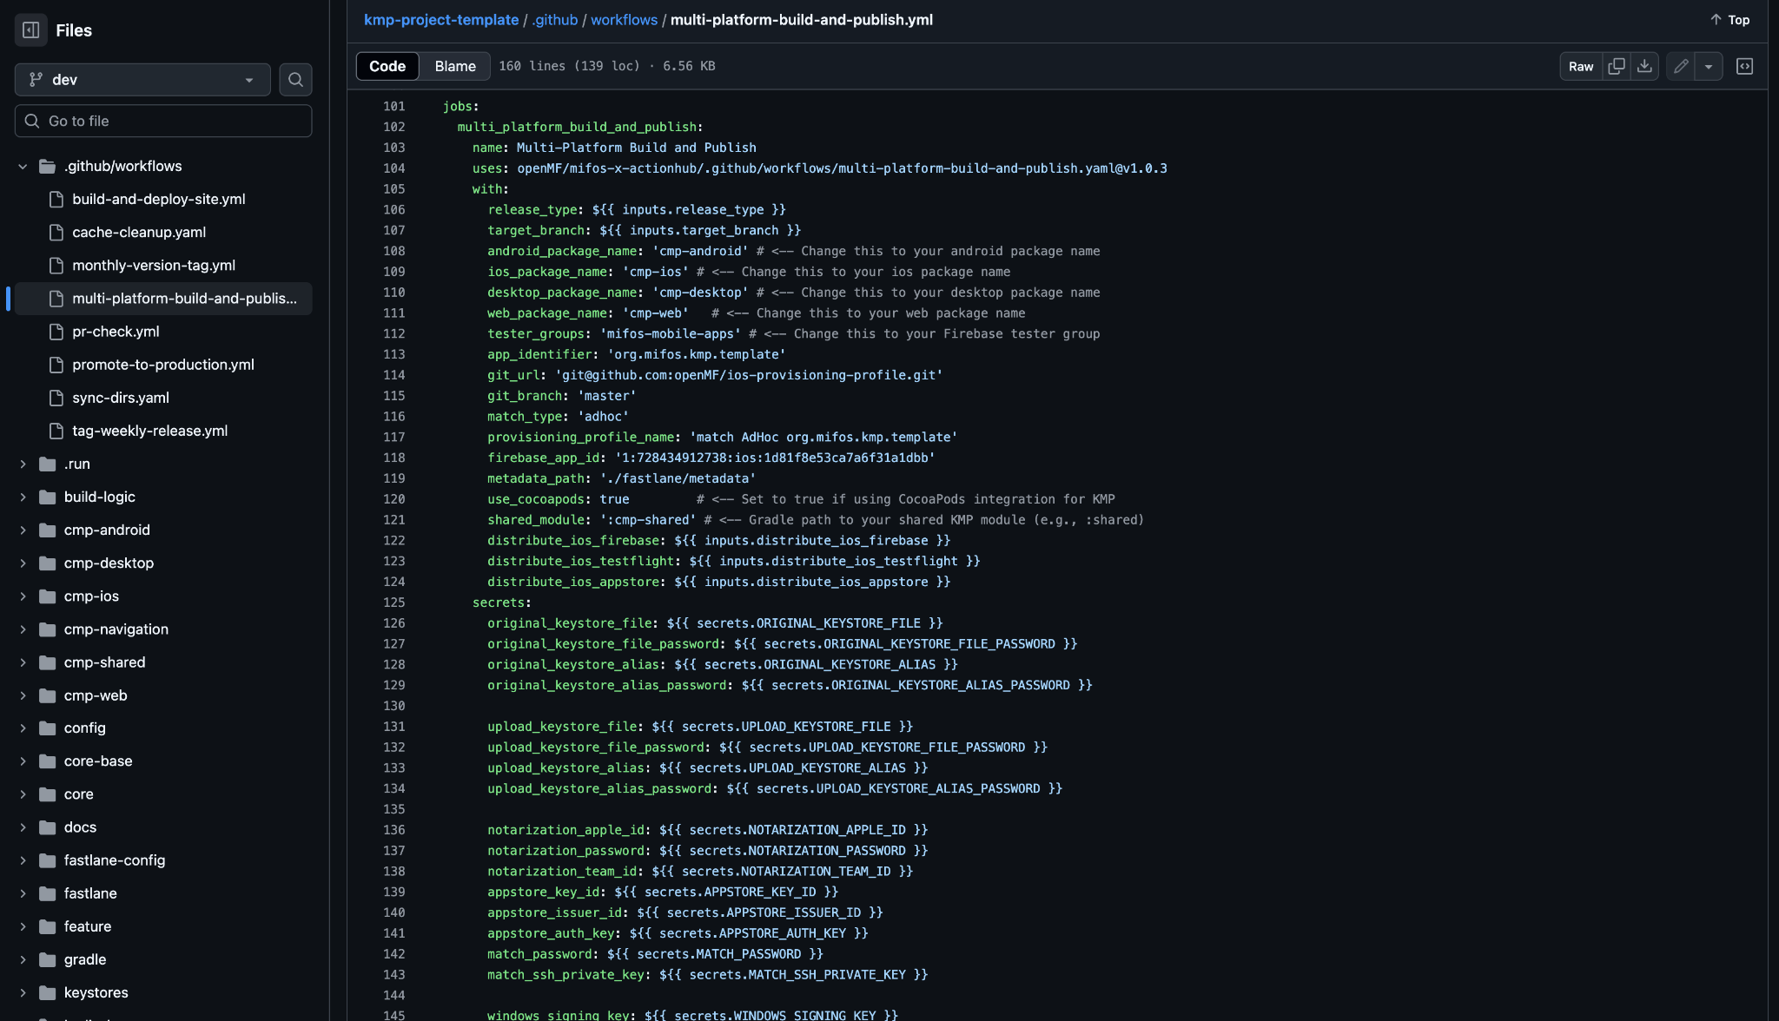
Automated Security and Keystore Management
Keystore Management System
The template includes comprehensive automation for Android application signing and certificate management. This system eliminates the complex manual processes traditionally required for secure application deployment while ensuring compliance with Google Play Store requirements.
The keystore management tool automatically generates both development and production certificates with appropriate security configurations. The system converts certificates to formats required by continuous integration pipelines and manages them as encrypted secrets within repository workflows.

Slide 7
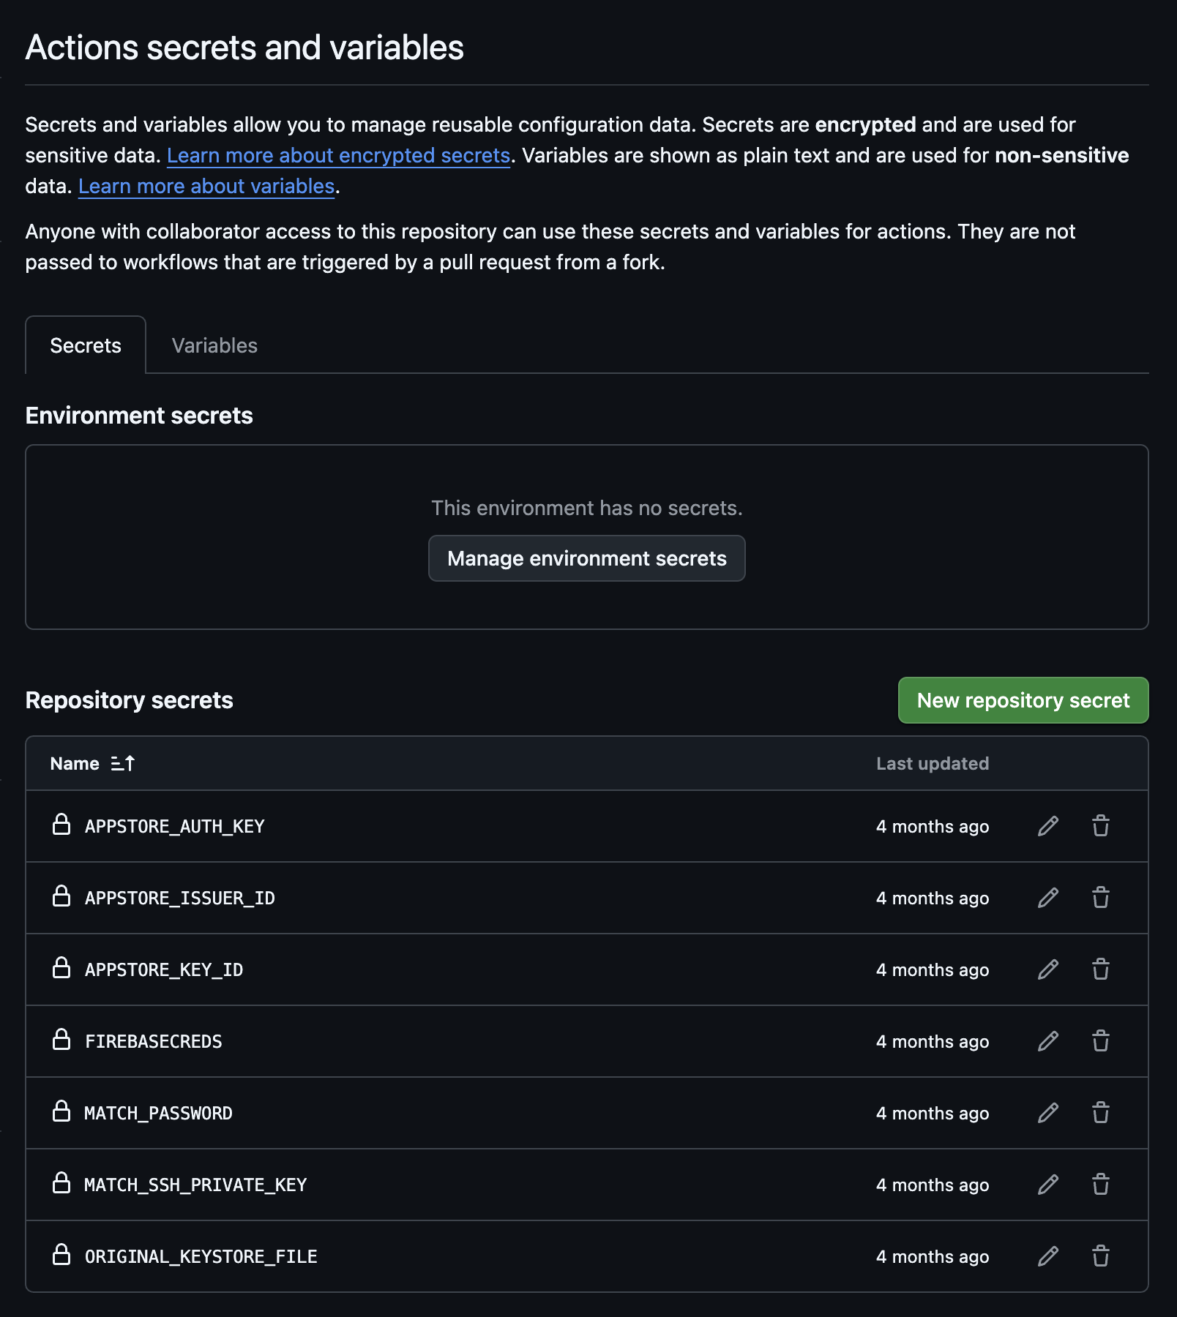
Automated Security and Keystore Management
Security Integration
The tool integrates seamlessly with GitHub Actions and other continuous integration systems to provide secure, automated deployment capabilities. Development teams can deploy applications to production environments without manually handling sensitive certificate files or exposing security credentials in build configurations.
This automation significantly reduces the time required for initial project setup while eliminating common security vulnerabilities associated with manual certificate management processes.

Slide 8
Source Set Hierarchy
The Foundation of Code Sharing
The template implements a sophisticated source set hierarchy that organizes code based on platform characteristics and capabilities. This system enables efficient code sharing while maintaining the flexibility to provide platform-specific implementations when necessary.
How the Hierarchy Works
Code organization follows a hierarchical structure where shared functionality resides at higher levels and platform-specific implementations exist at lower levels. The system automatically makes code available to appropriate platforms based on their position in the hierarchy.
Common Foundation: Core business logic, data models, and shared utilities that work across all platforms
Platform Groups: Intermediate layers that group platforms with similar characteristics and capabilities
Specific Implementations: Platform-targeted code that provides native functionality and optimizations
This approach eliminates code duplication while preserving the ability to optimize for specific platform requirements and user experience standards.

Slide 9
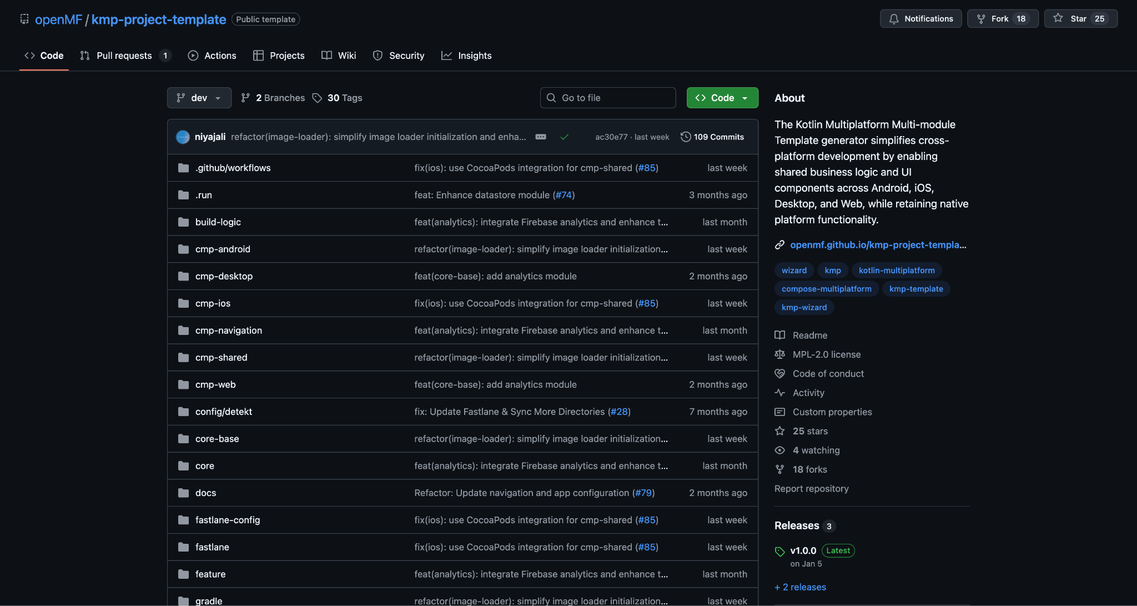
Source Set Hierarchy

Slide 10
Design System and Platform Integration
The Foundation of Code Sharing
The design system module provides comprehensive visual identity and user interface components based on Material Design principles. This module ensures consistent appearance and behavior across all platforms while adapting appropriately to platform-specific design guidelines.
The system includes responsive layouts that automatically adjust to different screen sizes and device orientations. Applications maintain professional appearance standards on mobile phones, tablets, desktop computers, and web browsers without additional configuration.
Platform Integration Module
This module manages the complexity of integrating with platform-specific capabilities while providing unified development interfaces. The system handles features such as content sharing, application updates, review prompts, and device-specific functionality.
Developers work with consistent programming interfaces regardless of the target platform. The module automatically provides appropriate implementations for Android system integration, iOS framework access, desktop environment features, and web browser capabilities.
The abstraction layer significantly reduces development complexity while ensuring users receive native platform experiences optimized for their specific devices and operating systems.

Slide 11
UI Foundation and Analytics Systems
User Interface Foundation Module
This module establishes the architectural patterns and development tools necessary for building responsive, maintainable user interfaces. The system implements proven state management patterns that prevent common programming errors while ensuring smooth user experiences across all platforms.
The module includes comprehensive performance monitoring capabilities that identify and resolve interface performance issues before they impact users. Applications built with this foundation maintain responsive performance standards regardless of complexity or data volume.
Analytics and Monitoring Module
The analytics module provides comprehensive application monitoring and user behavior tracking capabilities that function consistently across all supported platforms. The system implements type-safe interfaces that prevent common tracking implementation errors while supporting integration with popular analytics services.
Development teams receive real-time performance metrics, error reporting, and user interaction data that enables informed decision-making and proactive issue resolution. The monitoring capabilities support both technical performance optimization and business intelligence requirements.
The module maintains user privacy standards while providing detailed insights into application usage patterns and performance characteristics across different platforms and user environments.

Slide 12
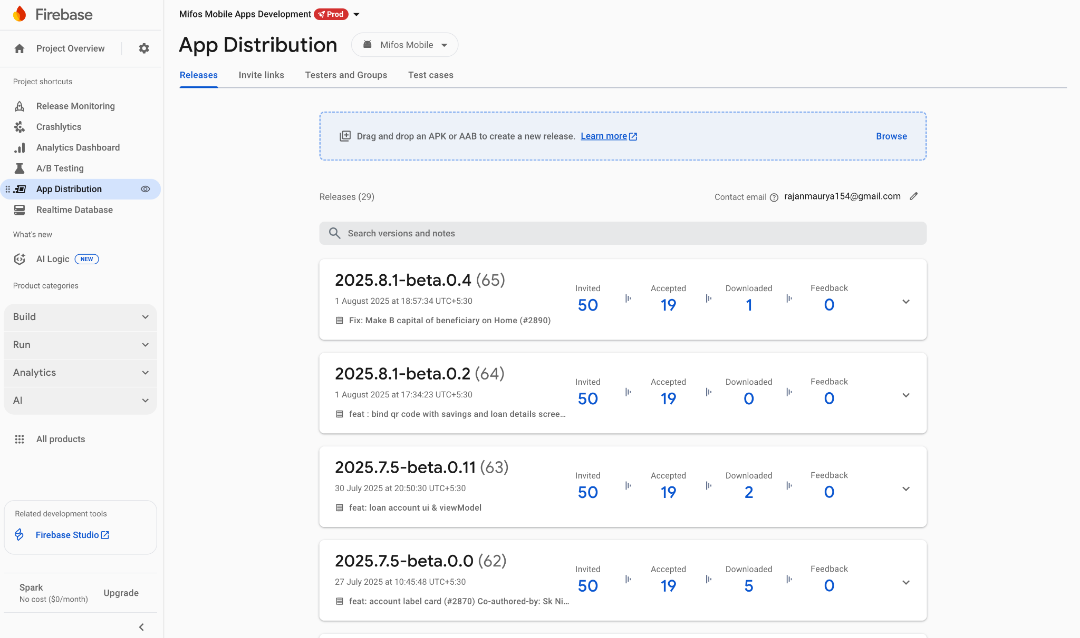
UI Foundation and Analytics Systems

Slide 13
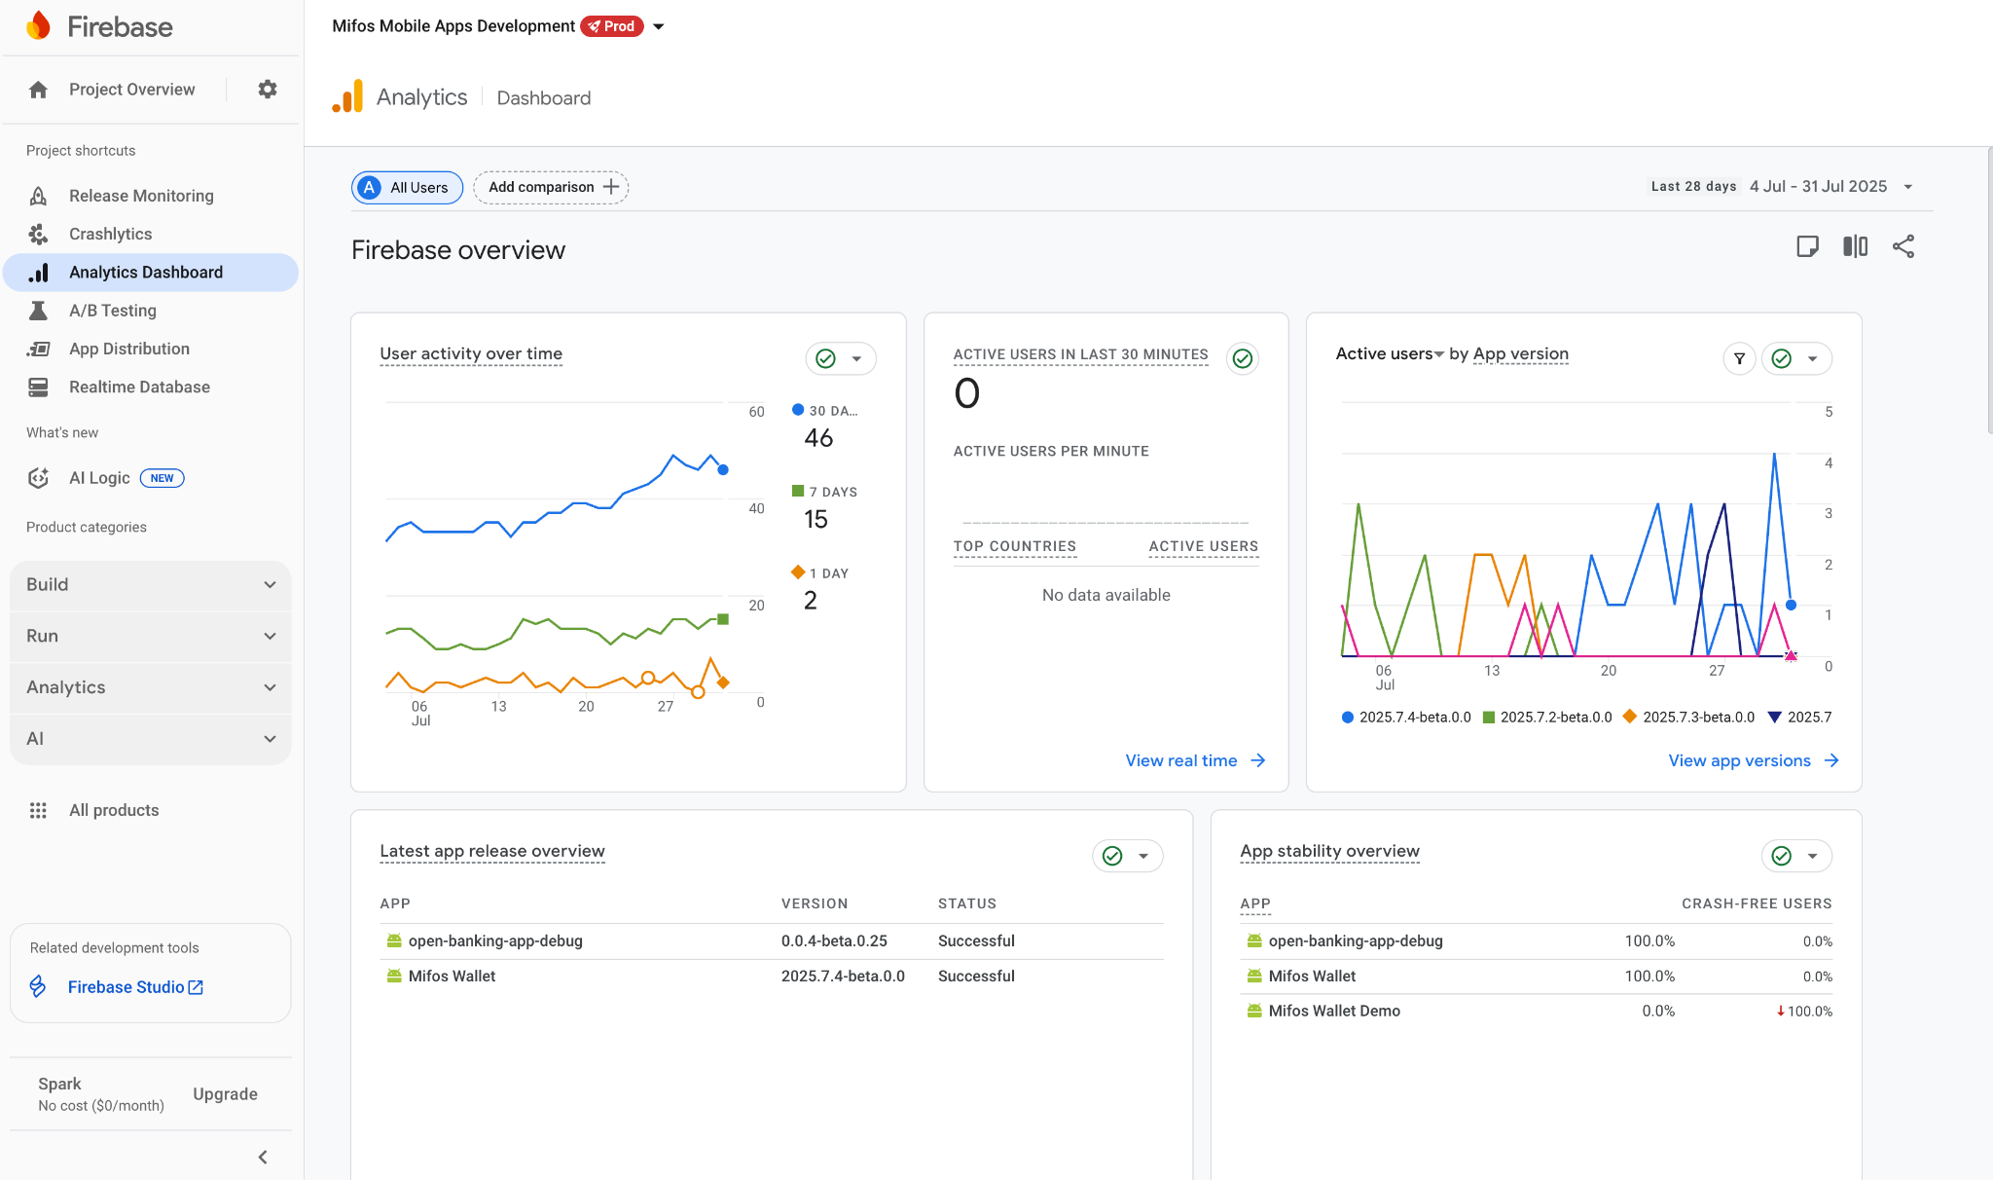
UI Foundation and Analytics Systems

Slide 14
Type-Safe Navigation
Modern Navigation System
The template implements sophisticated navigation architecture that eliminates common application crashes and user experience issues through type-safe routing mechanisms. This system verifies navigation paths and data transfers during development rather than allowing errors to reach production users.
The navigation framework includes smooth visual transitions that follow platform design guidelines while maintaining consistency across different devices and environments. These transitions enhance perceived application quality and create professional user experiences without requiring additional development effort.
Integration Capabilities
The navigation system provides comprehensive deep link support that enables users to share specific application screens and content across platforms. This capability supports marketing initiatives, customer service workflows, and user engagement strategies while maintaining security and authentication requirements.
The system integrates seamlessly with application state management to ensure that user interface components receive appropriate data regardless of navigation paths. This integration prevents common issues such as outdated information display or data loss during screen transitions.

Slide 15
THANK YOU!

